Slide 1
Chapter 4
Using RMAN

Slide 2
Objectives
Starting the RMAN Client
Basic RMAN commands
Connecting to target database
Executing O/S commands
Scripting RMAN
RMAN command Files
Connecting to auxiliary databases

Slide 3
Objectives (cont.)
Executing multiple commands
Issuing SQL from within RMAN
Starting up/shutting down database
Checking RMAN syntax
Hiding passwords
Identifying RMAN server sessions
Dropping database within RMAN

Slide 4
Starting The RMAN Client
Mandatory items are:
  ‘rman’ executable
  Target database
RMAN Repository
  Stores metadata about all backup & recovery actions
  Can be stored within:
    Target Database control file
    Optional recovery catalog

Slide 5
Starting The RMAN Client (cont).
Need proper credentials to log in:
  Operating system, or
  Database authentication
Other aspects of RMAN Environment
  Flash Recovery Area
  Media Management Layer (MML)

Slide 6
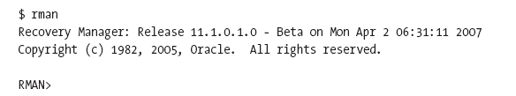

Starting The RMAN Client (cont).
Starting the client
Stopping the client
Or,

Slide 7
Basic RMAN Commands
Free-form command language
  Keyword
  Arguments
  End with semicolon
  Comments preceded with ‘#’

Slide 8



Basic RMAN Commands (cont).
Examples:

Slide 9

Basic RMAN Commands
Commands to save output from RMAN

Slide 10

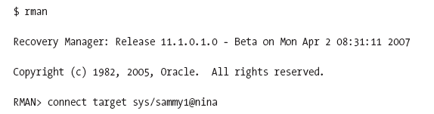
Connecting to Target Database
From within RMAN

Slide 11


Connecting to Target (cont.)
From O/S

Slide 12
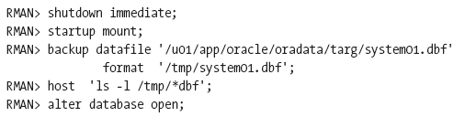
Executing O/S Commands
Using ‘host’ command

Slide 13
Scripting RMAN
Automate the RMAN process
Common to place in O/S shell script
‘EOF’ notation reads RMAN input from script
Can place RMAN scripts in files
Embed RMAN scripts within shell scripts

Slide 14
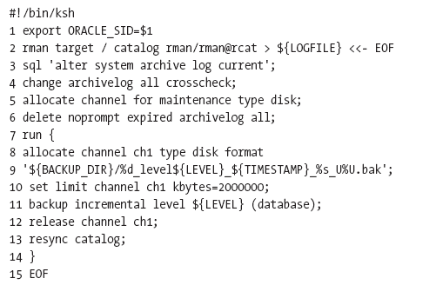
Scripting RMAN (cont.)

Slide 15



Scripting RMAN (cont.)

Slide 16

RMAN Command Files
Place RMAN commands in script
Run script within ‘rman command using ‘cmdfile’ keyword

Slide 17
Dynamic Command Files
Can use for multiple jobs
Pass in substitution variables
Steps include
  Creating RMAN command file
  Creating shell script to run command file
  Run shell script with passed-in variables

Slide 18
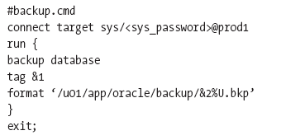
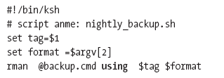
Dynamic Command Files (cont.)
Creating RMAN command file
Creating shell script to run command file
Run shell script with passed-in variables

Slide 19


Connecting to Auxiliary Database
Duplicate a database
Tablespace Point-in-time recovery (TSPITR)
Use ‘auxiliary’ keyword
Connecting within RMAN
Connecting within O/S

Slide 20
Executing Multiple Commands
Done via ‘run’ block
RMAN treats set of commands as one block
Executed sequentially
Delimited by curly braces
Useful to override default configuration settings

Slide 21
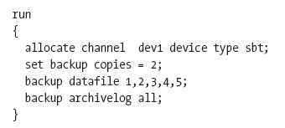
Multiple Commands Example
Setting default retention to 3 copies
Overriding default 3 copy configuration within block

Slide 22
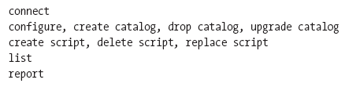
Limitations of Run Block
Can use following commands only within a ‘run’ block:
  Allocate channel
  Set newname for datafile
Cannot use the following commands within a ‘run’ block:

Slide 23
Issuing SQL from RMAN
Use keyword ‘SQL’ followed by statement
Enclose SQL statement within quotes
Can run SQL statements within ‘run’ block
Limited to commands that don’t return data
  Cannot issue ‘select’ statement within RMAN

Slide 24

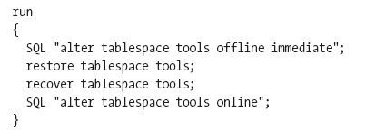
Issuing SQL from RMAN (cont.)
Executing SQL from RMAN prompt
Executing SQL from ‘run’ block

Slide 25
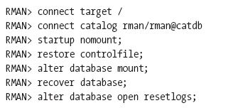
Starting Up Database
Use same ‘startup’ command as SQL*Plus
Example of starting up/recovering controlfile

Slide 26


Starting Up Database (cont.)
Steps of starting up without parameter file

Slide 27
Shutting Down Database
Use same ‘shutdown’ command as SQL*Plus
  Normal
  Immediate
  Transactional
  abort
Can only issue startup/shutdown for target database
For recovery catalog, connect directly and issue relevant command

Slide 28
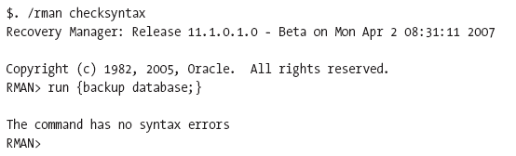
Checking RMAN Syntax
Can check syntax without executing commands
Use ‘checksyntax’ argument

Slide 29
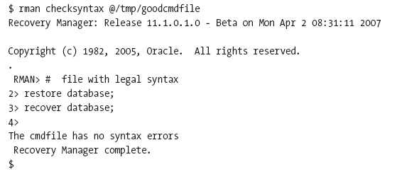

Checking RMAN Syntax (cont.)
Can also check syntax of command files
Can open session just for syntax checking

Slide 30
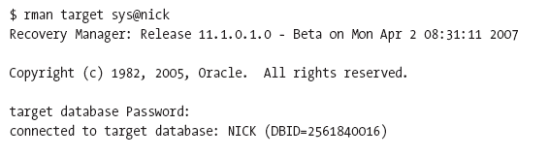
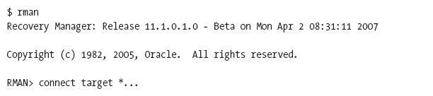
Hiding Passwords
Interactively (enter password, is hidden from view)
When running command files (is not logged)

Slide 31
Identifying RMAN Server Sessions
Use formula C+2
  C is number of channels
  N is number of “connect” options in allocate channel (if none, 1 is used)
Recovery Catalog uses at least 2 sessions
  One for connection to recovery catalog
  One for connection to target database

Slide 32



Dropping Database from RMAN
Can also drop database from SQL*Plus
Steps from within RMAN
  Startup mount
  Issue drop database command
  Enter confirmation for drop database command

